Slide 1

Tablet Pilot

Slide 2
We have recently completed the test launch phase of our tablet pilot program at our Northern and Downtown locations. We have achieved all of our goals and milestones thanks to the hard work from our team spooners. Milestone tasks completed:
-Procuring and Installing both hardware and software required for new Tablets.
-Coordinating with internal teams for our new menu and coupon systems
-Developed training and security protocols for the new equipment
Executive Summary

Slide 3
Overview
With our pilot program we had several achievable measurable goals:
-Reduce our average ticket time for appetizers to <8Mins, <15Minutes for entrees
-Have a check out time of <1Minute
-Reduce customer lobby wait time to <10 minutes
-Reduce Order Compensations and errors
-Improve Customer experience

Slide 4
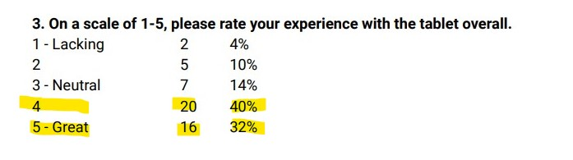
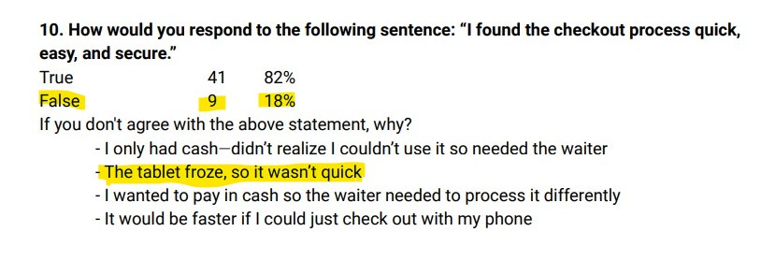
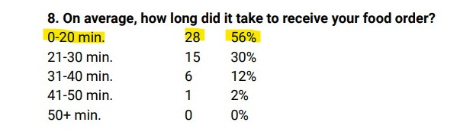
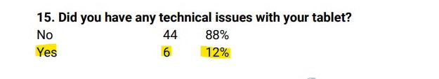
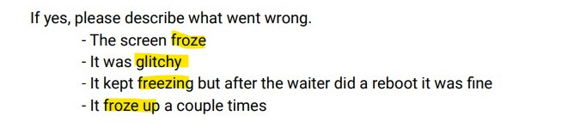
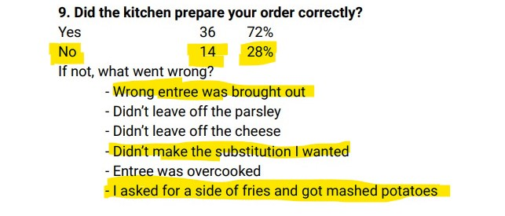
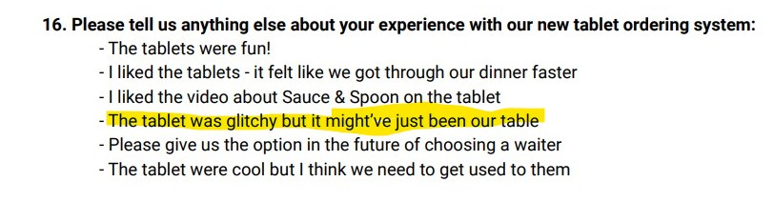
Findings:
72% good/great
Overall experience!
86% received their food in less than 30 minutes!
28% order error

Slide 5
Next Steps
Results: Test survey conducted on 50 of our customers
The Good:
86% of our customers had a neutral or positive experience with the tablets.
86% received their food in less than 30 minutes
82% found the checkout process quick, easy, and secure
78% of the users signed up for our newsletter
The Bad:
-54% of customers had to wait over fifteen minutes for a table
-28% incorrect food orders. Human error or software?
The Ugly:
-12% of our users reported technical issues with our tablets

Slide 6
Next Steps
-54% of customers had to wait over fifteen minutes for a table
Find out and improve upon why our customers had to wait over 15 minutes to be seated, we can analyze existing table turn times.
-28% incorrect food orders. Human error or software?
This is a large amount of compensations, or lost profit. We will need to investigate what is the root cause of this; front end, back end, user error, software, or hardware?
-12% of our users reported technical issues with our tablets
We received multiple reports on “frozen” and “glitching”. We would need to investigate to see if it is a hardware issue on one or more of the tablets or a software issue causing something like a memory leak. 12% is a large amount on something that can/should be close to 0% and negatively affects our customer experience.

